Slide 1
LecTure#12 Introduction to Machine Learning

Slide 2
Agenda
Why Machine Learning introduces?
Machine Learning Definitions
Applications
Machine Learning Process Flow
Types of Machine Learning Algorithms
Summary

Slide 3
Why Machine Learning introduces & what we achieved using Machine learning?
Data Generation
Data Analytics
Patterns
Algorithm
When we do not have algorithm?
When we do not need to learn?
Learning means approximation?

Slide 4
What is Machine Learning?
It provides systems the ability to automatically learn and improve from experience without being explicitly programmed.
“Learning is any process by which a system improves performance from experience.” - Herbert Simon
Definition by Tom Mitchell (1998):
Machine Learning is the study of algorithms that
• improve their performance P
• at some task T
• with experience E.
A well-defined learning task is given by <P, T, E>.

Slide 5
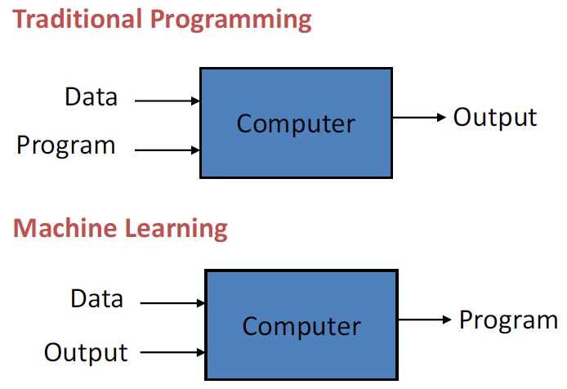
What is Machine Learning?

Slide 6
Applications
Image processing and Computer Vision
Face recognition, motion detection & object detection
Computational biology
Tumor detection, drug discovery, DNA sequencing
Energy production
Price and load forecasting
Automotive, aerospace, and manufacturing
predictive maintenance
Natural Language Processing
practical speech recognition
…

Slide 7
When should you use machine learning
Hand-written rules and equations are too complex—
as in face recognition and speech recognition.
The rules of a task are constantly changing
as in fraud detection from transaction records.
The nature of the data keeps changing, and the program needs to adapt—
as in automated trading, energy demand forecasting, and predicting shopping trends.

Slide 8
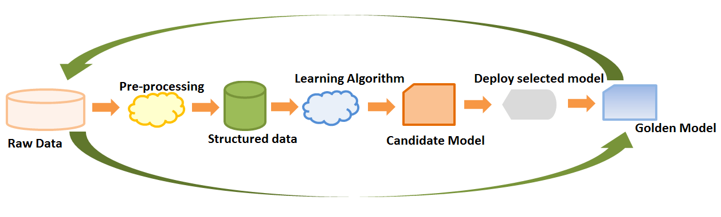
Machine Learning Process flow
Identifies relevant data sets and prepares them for analysis.
Choose the type of machine learning algorithm to use.
Builds an analytical model based on the chosen algorithm.
Trains the model on test datasets revising it as needed.
Run the model to generate scores and other findings.
.

Slide 9
Type of learning algorithms
Supervised learning
Unsupervised learning
Reinforcement learning

Slide 10
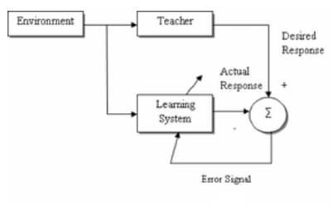
Machine Learning Methods
Supervised Learning: Use labeled training data to learn the mapping function from the input variables (X) to the output variable (Y).

Slide 11
Supervised learning
It build a mathematical model of a set of data that contains both the inputs and the desired outputs.
Data scientists determine which variables, or features, the model should analyze and use to develop predictions.
Once training is complete, the algorithm will apply what was learned to new data.

Slide 12
Example:
Suppose you are given an basket filled with different kinds of fruits.
Now the first step is to train the machine with all different fruits one by one like this
If shape of object is rounded and depression at top having color Red then it will be labelled as –Apple.
If shape of object is long curving cylinder having color Green-Yellow then it will be labelled as –Banana.
Notes:
https://www.geeksforgeeks.org/supervised-unsupervised-learning/
For instance, suppose…
…
Now suppose after training the data, you have given a new separate fruit say Banana from basket and asked to identify it.
Since machine has already learnt the things from previous data and this time have to use it wisely.
It will first classify the fruit with its shape and color, and would confirm the fruit name as BANANA and put it in Banana category.
Thus machine learns the things from training data(basket containing fruits) and then apply the knowledge to test data(new fruit).
Supervised learning classified into two categories of algorithms:
Classification: A classification problem is when the output variable is a category, such as “Red” or “blue” or “disease” and “no disease”.
Regression: A regression problem is when the output variable is a real value, such as “dollars” or “weight”.

Slide 13
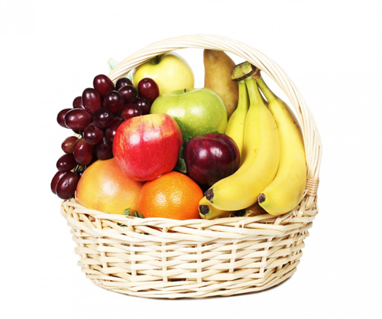

Example:
Now suppose after training the data, you have given a new separate fruit say Banana from basket and asked to identify it.

Slide 14
Supervised Learning : Important Concepts
Data: labeled instances <x_{i}, y>, e.g. emails marked spam/not spam
Training Set
Held-out Set
Test Set
Features: attribute-value pairs which characterize each x
Experimentation cycle
Learn parameters (e.g. model probabilities) on training set
Compute accuracy of test set
Very important: never “peek” at the test set!
Evaluation
Accuracy: fraction of instances predicted correctly
Overfitting and generalization
Want a classifier which does well on test data
Overfitting: fitting the training data very closely, but not generalizing well

Slide 15
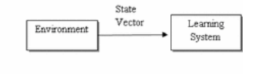
Machine Learning Methods
Unsupervised Learning: Only data is given, no labels provided

Slide 16

Unsupervised Learning
It do not need to be trained with desired outcome data.
Suppose it is given an image having both dogs and cats which have not seen ever.

Slide 17
Unsupervised Learning
Thus machine has no any idea about the features of dogs and cat so we can’t categorize it in dogs and cats.
But it can categorize them according to their similarities, patterns and differences i.e., we can easily categorize the above picture into two parts.
First may contain all pics having dogs in it and second part may contain all pics having cats in it.
Here you didn’t learn anything before, means no training data or examples.

Slide 18
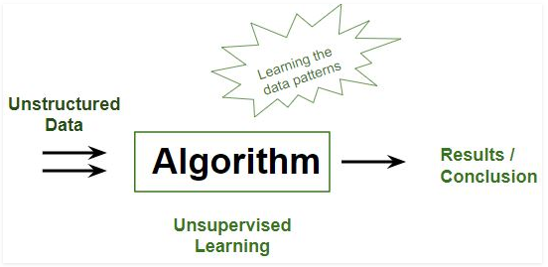
Unsupervised Learning

Slide 19
Semi supervised learning
It fall somewhere in between supervised and unsupervised learning
Since they use both labeled and unlabeled data for training
Typically a small amount of labeled data and a large amount of unlabeled data
Applications
Speech analysis, web content classification etc.

Slide 20
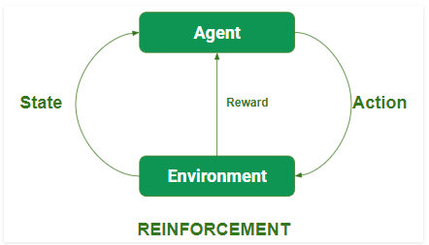
Reinforcement learning

Slide 21
Reinforcement learning
Reward feedback in a particular situation.
To find the best possible behavior or path it should take in a specific situation.
Reinforcement learning differs from the supervised learning in a way that in supervised learning the training data has the answer key with it so the model is trained with the correct answer itself whereas in reinforcement learning, there is no answer but the reinforcement agent decides what to do to perform the given task.
In the absence of training dataset, it is bound to learn from its experience.

Slide 22
Sub-Type of learning algorithms
Machine Learning
Supervised Learning
Unsupervised Learning
Classification
Regression
Clustering
SVM,
Naïve Bayes,
Nearest Neighbor
…
Linear regression, Logistic regression
Decision trees,
Neural Networks
…
K mean, Fuzzy, HMM, Gaussian Mixture
…

Slide 23
Summary
Machine learning (ML) is a relevant, popular topic with applications spanning many data-driven tasks
ML spans tasks in inductive reasoning; unlike classic AI, ML infers general patterns from specific samples
ML algorithms can be viewed as pattern analyzers—the patterns they find can be used to make predictions
Common tasks in ML include regression, classification, subspace discovery, & clustering
Learning algorithms face challenges including choosing an inductive bias, under- & over-fitting, & computational efficiency

